Slide 1


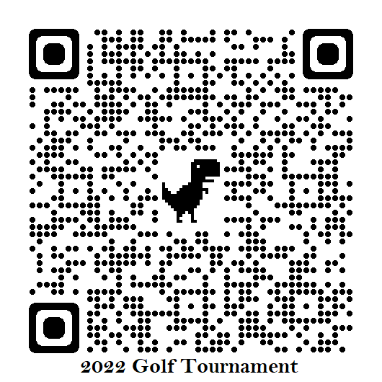
Golf Tournament
Redmond Ridge Golf Course
Saturday, September 24th
Shot Gun Start at 8:00 AM
All proceeds benefit the Fr. Mike Schmitt Tuition Assistance
Early Bird $135 (Register by June 10th)
Regular Ticket $150
Fund

Slide 2
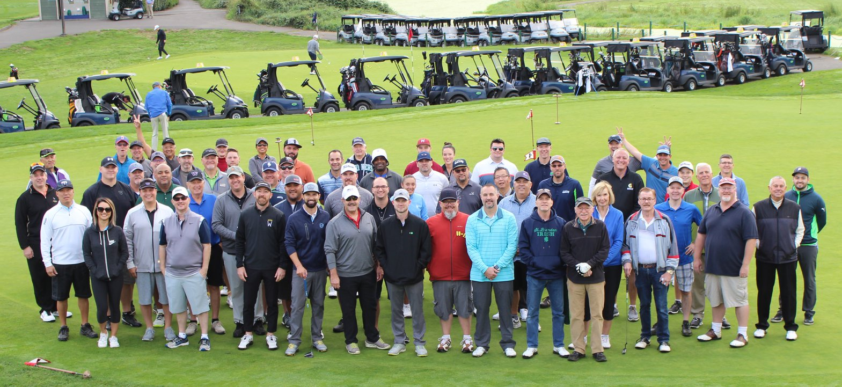
BUILDING A BETTER WORLD… ONE STUDENT AT A TIME.

